Slide 1


COMPREHENSIVE PLAN
2024 – 2026
NEEDS ASSESSMENT
Notes:
INSTRUCTIONS
This is the COVER of your needs assessment. Delete the placeholder logo and replace it with your county logo. From the Insert tab, select Pictures. Browse to the folder where your “color w white text” logo is stored. Select it and click Open. After the logo appears, double-click it to open the Format tab. Resize by clicking in the Width box and entering 2.5. Align the logo with the needs assessment title below.

Slide 2

Acknowledgments
Saluda County First Steps would like to acknowledge the support we received in successfully developing our Needs Assessment from input through our Saluda County Community Partners: Saluda County First Steps Board Members, Saluda School District One Administration and Staff Members, Saluda County DSS, Westview Behavioral Staff, Piedmont Agency on Aging (Foster Grandparents) Staff, Saluda Learning Center (EHS/HS GLEAMNS), The Potter’s House Saluda (Non-Profit), PASOs Community Health Worker and Administration, Saluda County DHEC and South Carolina DHEC Staff, Saluda County DJJ Staff, Saluda Police Department, Victim’s Advocate for the Town of Saluda, Saluda Mayor (Milliken Matthews), Saluda Chamber of Commerce, and the Town of Saluda Staff.
“The project described was supported through South Carolina First Steps by the Preschool Development Grant Birth through Five Initiative (PDG B-5), Grant Number 90TP0080-02-01 from the Office of Child Care, Administration for Children and Families, U.S. Department of Health and Human Services.”
Notes:
INSTRUCTIONS. Overwrite text box with acknowledgments if desired

Slide 4
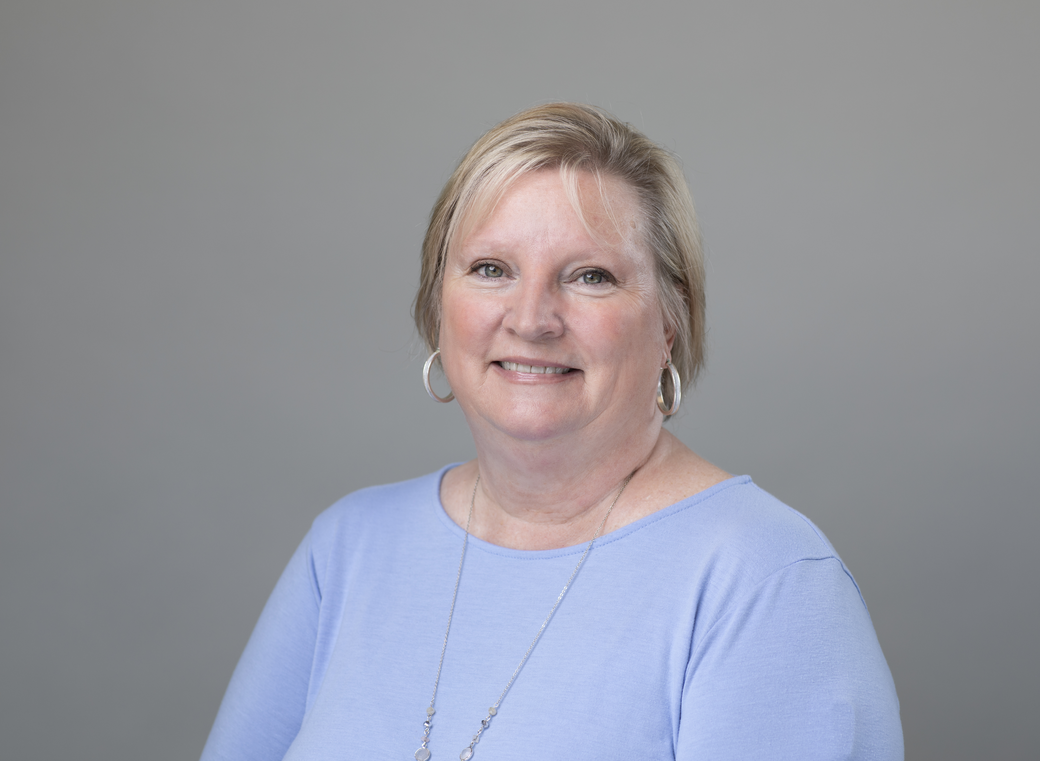
Message from the Executive Director
Kim Chariker
Executive Director
Saluda County First Steps
Interacting with a community that wants to see all of our young children succeed in school and life is what makes Saluda County special. Our #OneSaluda slogan has truly brought our community together to achieve success. The support shown to Saluda County First Steps during this Needs Assessment process has been nothing short of amazing. We all want to see the youth of our county succeed in all aspects of their lives and want a united community of support for families. We have the foundation to establish a Strategic Plan that will guide us in helping our young children be prepared to succeed in school and in life. Community partnerships are key to providing the tools necessary for our young children to reach their goals.
Kim Chariker
Notes:
TEXT: Use the text boxes provided to give an introduction to your partnership and outline your goals.
PHOTO & SIGNATURE: Delete the placeholder images and replace them with a high-quality photo and signature. (Insert > Pictures.) Double-click the images to open the Format tab, where you can crop and resize these images. Edit the text box below the ED photo with ED name and partnership name.

Slide 5



Needs Assessment Process
CONVENE
Held two community convenings with 39 participants and developed a vision for young children and their families
October 2022 – January 2023
UNDERSTAND
Reviewed local data and map assets to understand the state of young children, their families, and the early childhood system
October 2022 – March 2023
PRIORITIZE
Organized the insight gathered from the convenings and data to prioritize the concerns, needs, and gaps the partnership wants to address and formalized Needs Assessment
January 2023 –March 2023
“We need more of our Saluda services to be open after our working hours. We have to work, but sometimes we need help when offices are closed.” Hispanic Parent Survey Response
“I don’t think we have updated our community resource guide, so we don’t know what services are available to us. An updated Saluda County Resource Guide would benefit everyone.” Shanna Myers, The Potter’s House Saluda
Notes:
INSTRUCTIONS. Edit text boxes with details about each step with dates - use bottom of page to include quotes or photographs

Slide 6





Asset Map
Child Care Centers, Private Preschools and Family Homes
Saluda County Dentists and Dental Clinics
Piedmont Technical College
CHILD CARE & EDUCATION
Saluda County Physicians & Clinics
Saluda County Sheriff’s Department
Saluda County School District & King Academy
HEALTH & SAFETY
ABC Quality
Saluda County First Steps & SCFS 4K + Siblings
Saluda County EMS (CPR & First Aid) Classes for Parents
Town of Saluda Police Department
Saluda County Adult Education (Literacy)
PARENTING & FAMILY SUPPORT
Self Regional Healthcare, Lexington Medical Center, and Newberry Hospital
Saluda County DSS
(WIC, TANF,etc.)
Saluda County Recreation Department
Early Head Start and Headstart
Websites First Five, SC Thrive, and Family Connection
Saluda County Chamber of Commerce
Saluda County Health Department DHEC & DHHS
Carolina Behavioral and Beyond
Clemson Extension Cooking Classes
Local Churches Blessing Boxes
SPECIAL NEEDS & EARLY INT.
FOOD & NUTRITION
Saluda County Library
Backpack Buddies at Hollywood Elementary
Christ Central Food Bank
BabyNet and Child Find
Notes:
INSTRUCTIONS. See page 20

Slide 7
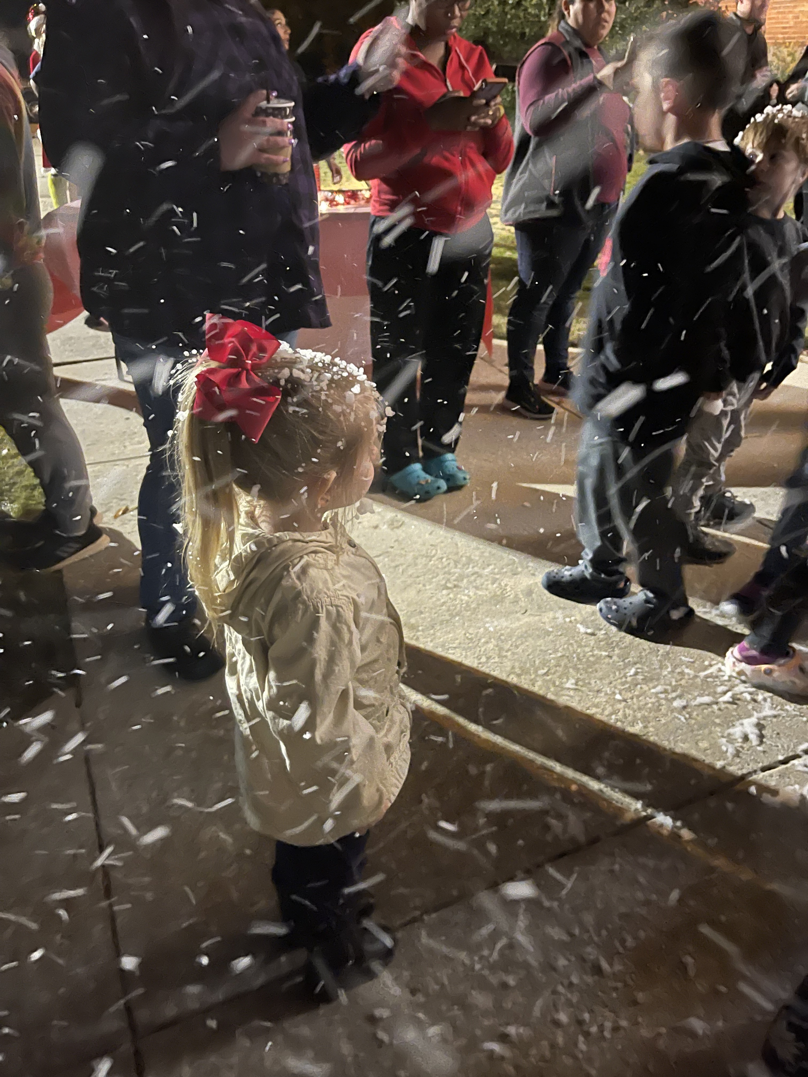
Priorities: Summary
Priorities for Saluda County as identified by parents, caregivers, extended family members, community partners, and stakeholders:
1. Need for more Parenting Skills/Parent Education
2. Need for an updated Saluda County Resource Guide for Families
3. Need for increased Tutoring for Saluda County Children in Need
4. Need for Literacy Classes and Resources for All Families (English
and Spanish)

Slide 8
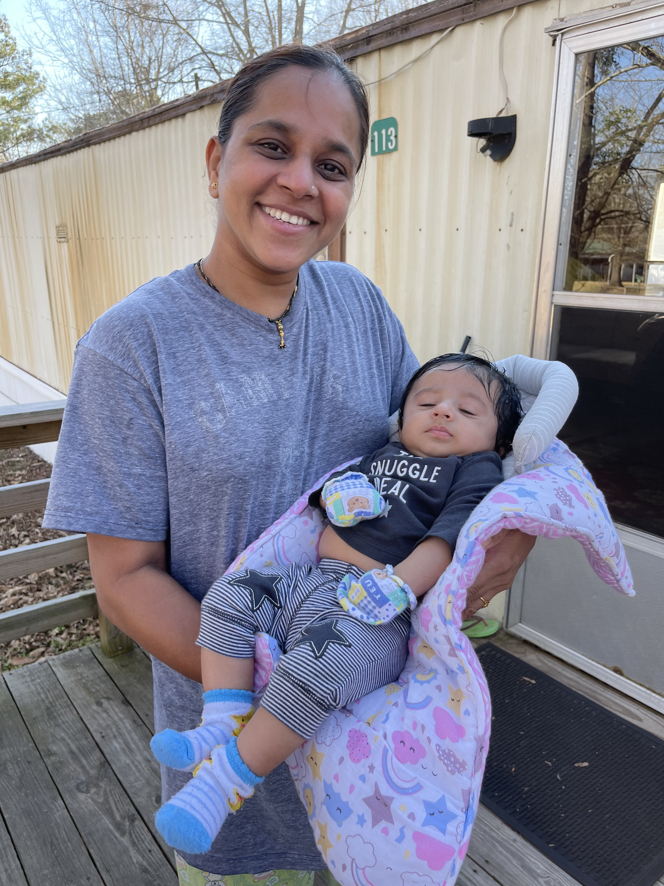
Priority One: Parenting Skills
Parent and Community Partner Surveys
Parent and Community Partner Surveys were distributed throughout Saluda County to determine the greatest needs within our community for the success of our young children. 45 parent surveys were received and 39 community partners, parents of young children, and board members participated in our Needs Assessment convener meetings held on January 17th and January 25th of this year.
“Parenting skills and Early Literacy Training for parents are some of the greatest needs in Saluda County.”Jennifer Thomas, Principal of Hollywood Elementary School

Slide 9
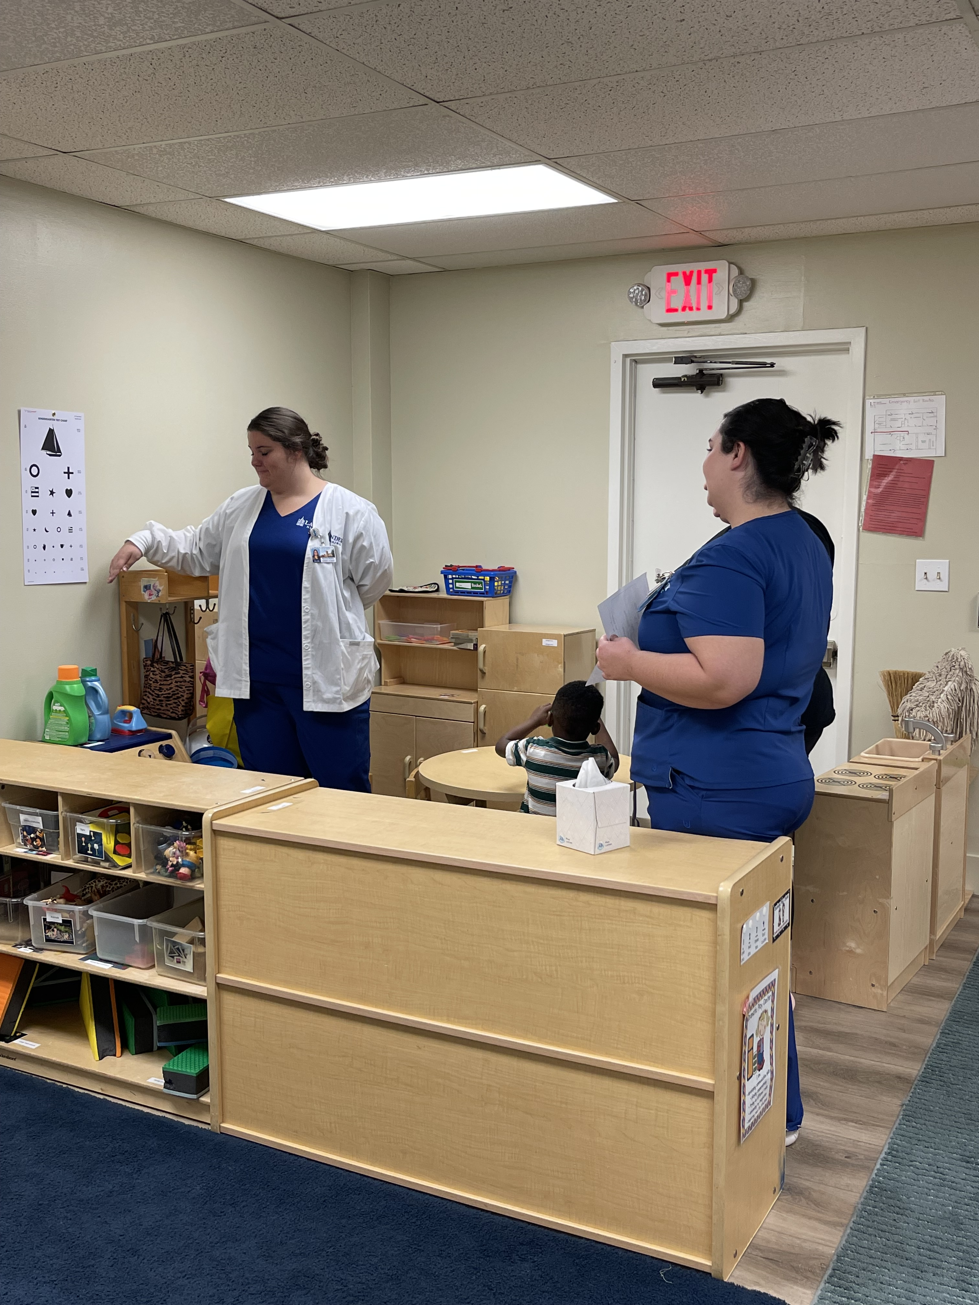
Priority Two: County Resource Guide
Need Updated Resource Guide for Saluda
During our local convenings, it was overwhelmingly determined that Saluda County was in need of an updated resource guide. This resource guide would assist families in need with locating information that would guide them to services within Saluda County. An update resource guide would also provide them with points of contact for services that not available within our county.
“We need support and collaboration among available programs in Saluda to provide the resources that our parents and care givers need.” Saluda County First Steps Board Member
“We really need an updated resource guide for Saluda to identify the services we currently have available and to determine what needs we have by reaching out to other agencies for assistance in the areas that we do not provide within our county.” Saluda FS Board Member

Slide 10
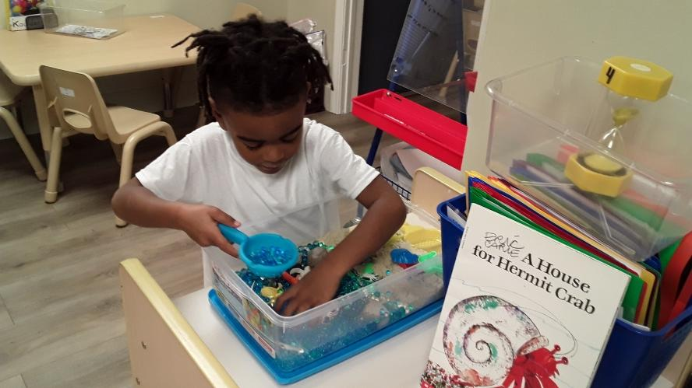
Priority Three: Tutoring for Children
Need for more Enhanced Early Education Services within Saluda County Child Care Centers and Saluda School District One
According to the 2021 Kindergarten Readiness Assessment reports, Saluda County children are only demonstrating kindergarten readiness skills at 9%. (KRA data sourced from SC Education Oversight Committee)
“As a community service provider, our greatest need is more early literacy intervention/tutoring services for our children.” Sarah Deloach, Principal Saluda Primary School

Slide 11
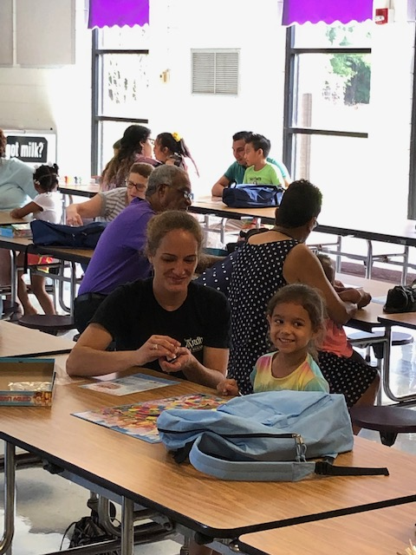
Priority Four: Literacy for Families
Family Literacy encourages success for children and their families
Saluda County families need literacy programs. Children and their parents need more literacy activities to encourage better education and growth within our community. (Source: FY24-26 Needs Assessment Parent and Community Partner Surveys)
“The parents need education in several areas such as school for higher education, health care, and parenting education.” Veronica Orndoff, PASOs Community Health Worker
“Children can be empowered by teaching their parents. Saluda has a huge need for English classes and other programs for immigrant parents.” Bruce Wright, DHEC Community Health Worker Supervisor

Slide 12




Next Steps
PLAN
Write the partnership’s three-year Strategic Plan using the Needs Assessment
March 2023 – May 2023
APPLY
Utilize the Strategic Plan to inform the partnership’s Annual Formula Funding Grant Application
May 2023, May 2024, May 2025
IMPLEMENT
Execute the programs and services outlined in the Strategic Plan
July 2023 –June 2026
MONITOR
Track the partnership’s progress on implementing programs to fidelity and on achieving the Strategic Plan
July 2023 – June 2026

